Slide 1


Final Project
Movie recommender
Team Member:
Xiantian Sun. xs884
Yufei Ren yr873
Ziyu Su. zs1254

Slide 2
Problem Statement
Using collaborative filtering and PCA to build a recommender based on user’s past rating of movies
Predict or filter preferences of movie according to the user’s choice.
Using dataset from http://files.grouplens.org/datasets/movielens/ml-latest-small.zip
Dataset contains movie dataset(movies information) and rating dataset(userID, moiveId, rating).
*
‹#›

Slide 3
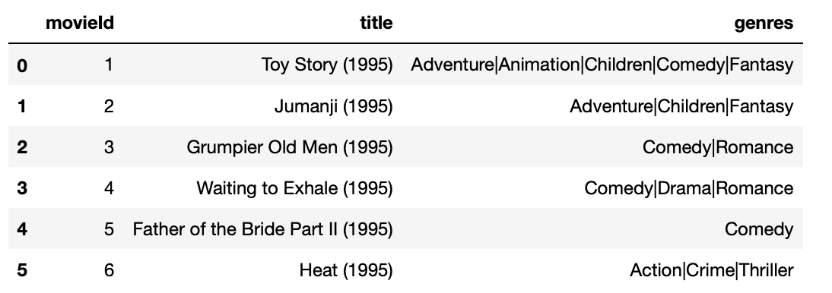
Movie Dataset(9743 movies)
*
‹#›

Slide 4
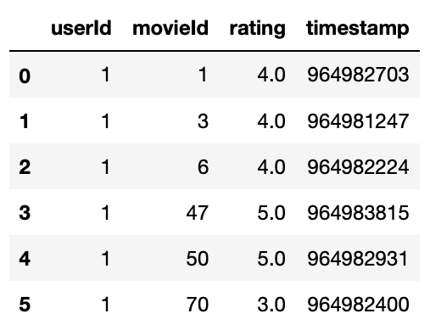
Rating Dataset(100836 rating data)
*
‹#›

Slide 5
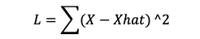
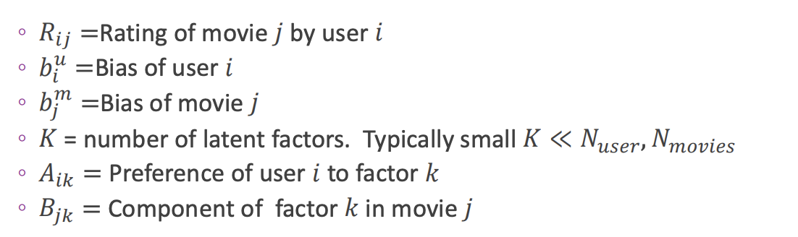
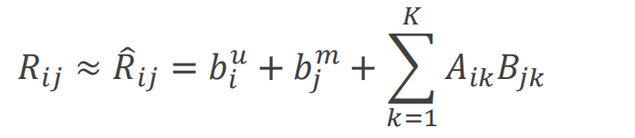
Loss function
Formulation
Ratings for movies dependent on small number of latent factors.
Mathematically model as:
Cited: Formulation from Pro. Sundeep Lec11 https://github.com/sdrangan/introml/blob/master/lectures/Lect11_PCA.pdf
‹#›

Slide 6
Training Procedures
Find all the ratings for each movie and construct as ratings matrix
Remove the mean for all the non-zero values.
Use PCA on the data and use K-fold to determine how many PCs can get the best accuracy.
Find the the prediction of X based on the PCA.
*
‹#›

Slide 7
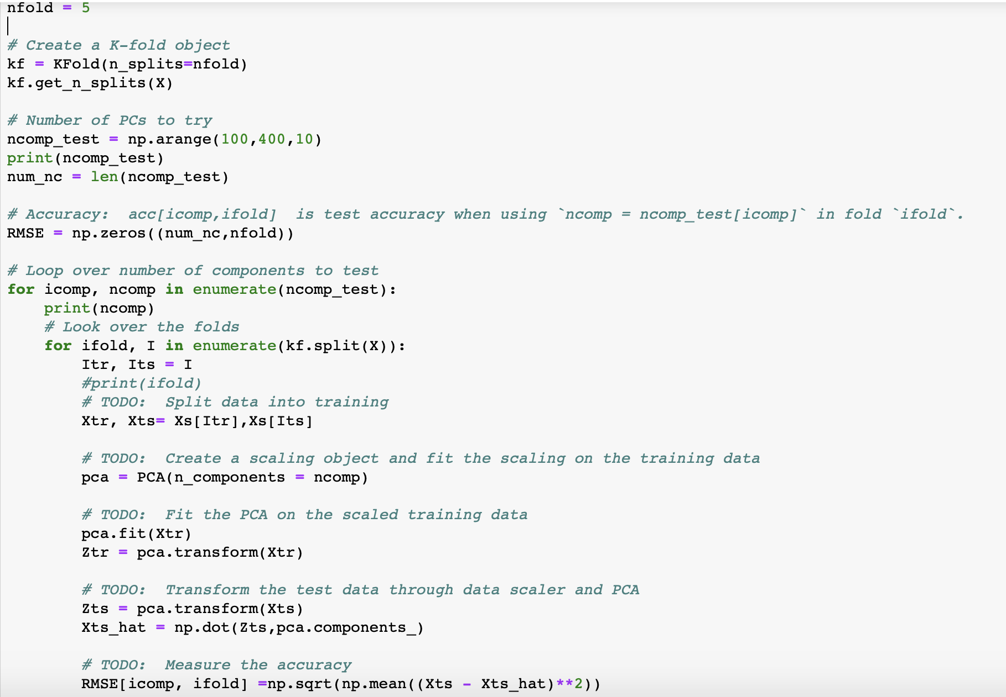
K-fold
As we use more and more PCs to compute the prediction, we can see our model perform better and better. Accordingly the runtime will increase. Since long runtime for this project, we used colab GPU to run the project.
*
‹#›

Slide 8
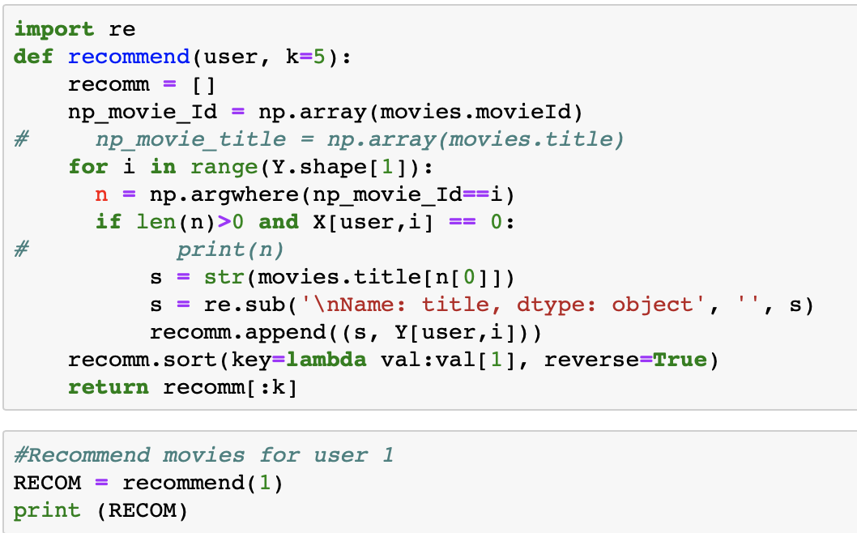
Evaluation Result
Recommend user several movies that user never watched based on recommender system
*
‹#›

Slide 9
Conclusion
The key method of this project is PCA and SVD. PCA can help us get rid of some noise of the dataset and find out several key factors(principle component), then we can use the component to do the reverse transform to get the predicted rating of each movie. We also do k-Fold, calculate the accuracy by comparing the predicted data and original data, compute the MSE on the units that is non-zero in the raw dataset.
To further improve the recommending accuracy, we will try to use a much larger dataset next time and try several other machine learning algorithms.
*
‹#›

